Slide 1
EU Maritime Transport Policy
Prospects and Challenges
Patrick Verhoeven
Mare Nostrum – Dubrovnik – 30 September 2014

Slide 2
Summary
Introduction to ECSA
Economic value of EU shipping
EU maritime strategy and the ‘Athens Declaration’
Shipping policy
Safety and environment
Social affairs
Conclusion

Slide 3
1. Introduction to ECSA

Slide 4
Established in 1965
National shipowner associations EU + Norway
All trades – all sectors
Based in Brussels – interlocutor EU institutions
Partner in EU maritime social dialogue
Network with other shipowner interest organisations

Slide 5
Structure
Board of Directors
Shipping Policy Committee
Safety & Environment Committee
Social Affairs Committee
State Aid WG
Ports WG
Taxation WG
Piracy WG
CO2 WG (MRV)
Sulphur WG
Legal Advisory Committee

Slide 6

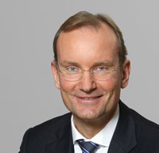
Presidency 2014-2015
Vice-President / President Elect:
Niels Smedegaard (DFDS)
President:
Thomas Rehder (Carsten Rehder)

Slide 7
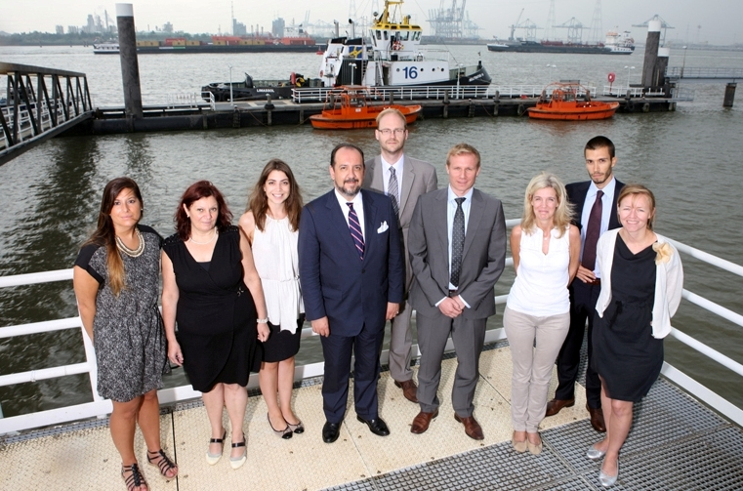
Secretariat

Slide 8
2. Economic value of EU shipping

Slide 9
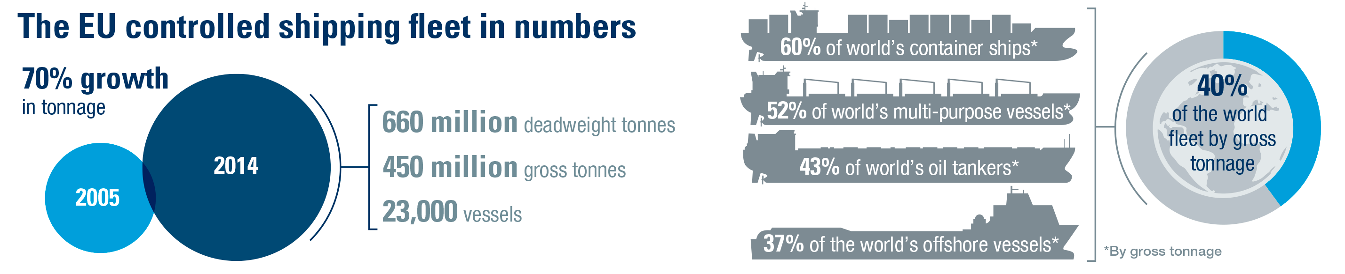
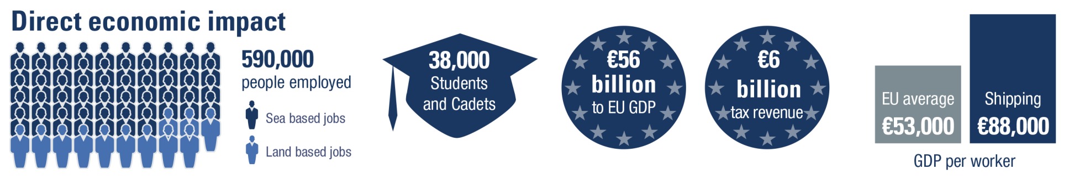
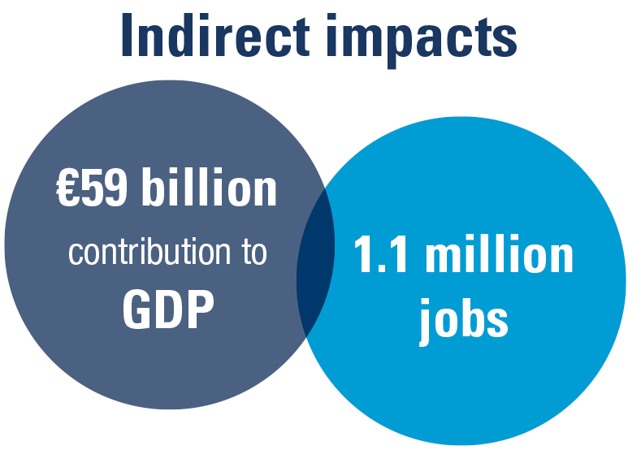

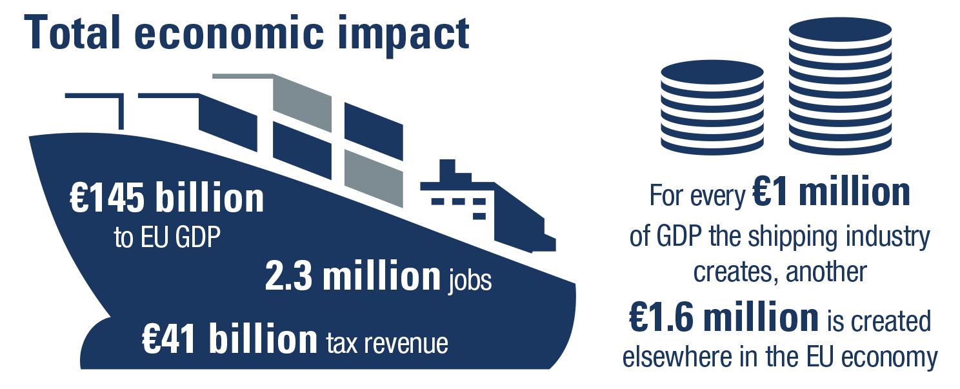
Source: Oxford Economics (2014)
9

Slide 10
3. EU maritime strategy and the ‘Athens Declaration’

Slide 11
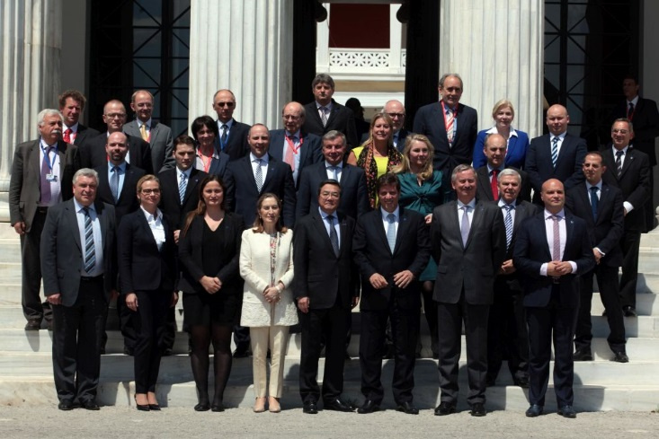
Informal meeting EU shipping ministers - Athens, 7 May 2014

Slide 12
Key messages
European shipping in globalised markets
Human resources, seamanship and maritime know-how
Quality shipping as a key competitive advantage
Working together on the international scene
Exploiting full potential of short-sea shipping and sea transportation services for business and citizens
Europe should be the world leader in maritime research and innovation

Slide 13
ECSA response
Sustain EU leadership in global shipping
Improve environmental performance, without losing competitive edge
Tap into the wealth of maritime skills and know-how
Establish a truly internal market for shipping and ports
Continue EU leadership in promoting free trade and secure seas

Slide 14
Next steps
Formal conclusions at June 2014 Transport Council
European Commission to prepare mid-term review of EU maritime transport strategy by spring 2015

Slide 15
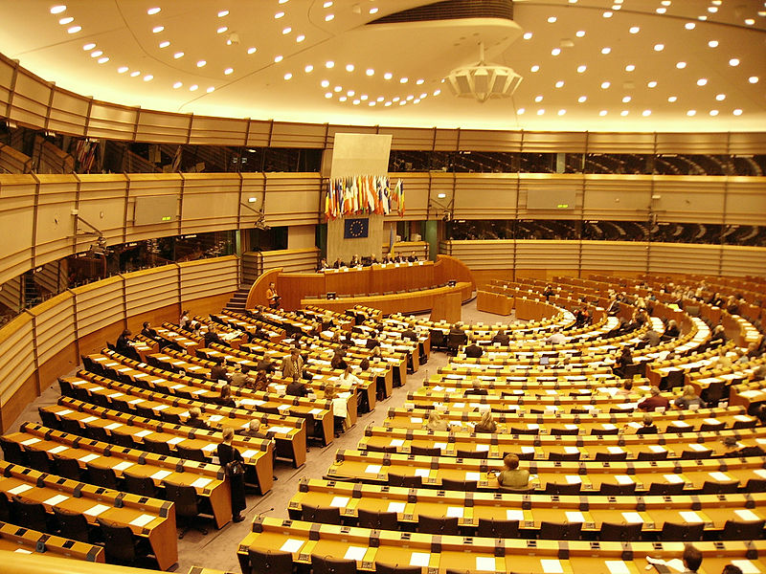
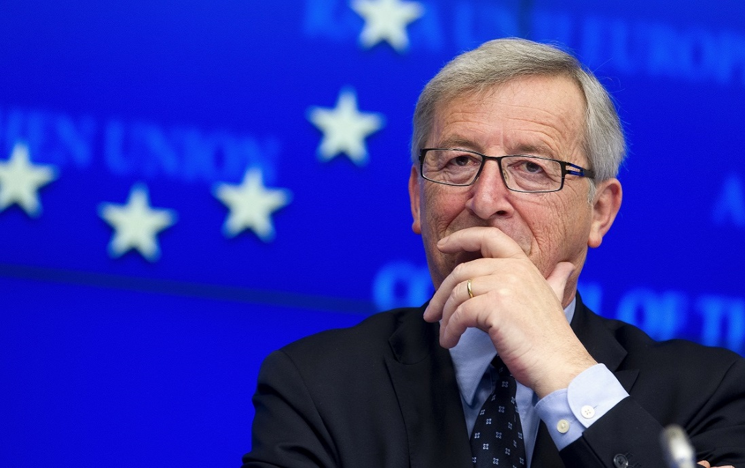
Institutional changes

Slide 16
3. Shipping policy

Slide 17
Competition policy
EU and global trade
Maritime security
Trade facilitation
Ports and logistics

Slide 18

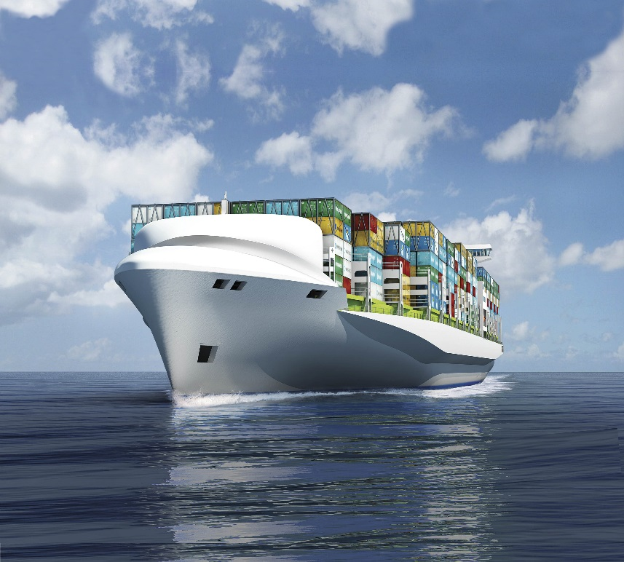
a) Competition policy

Slide 19
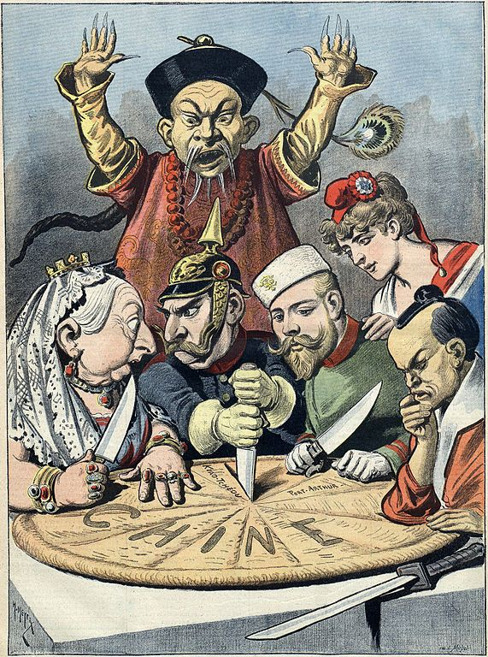
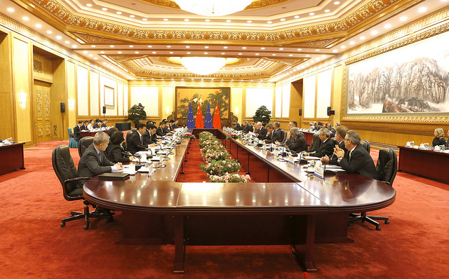
b) EU and global trade

Slide 20


c) Maritime security

Slide 21
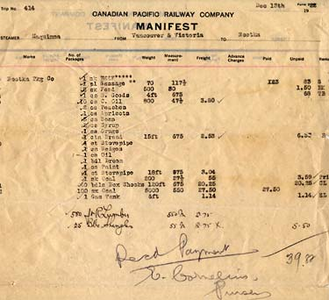
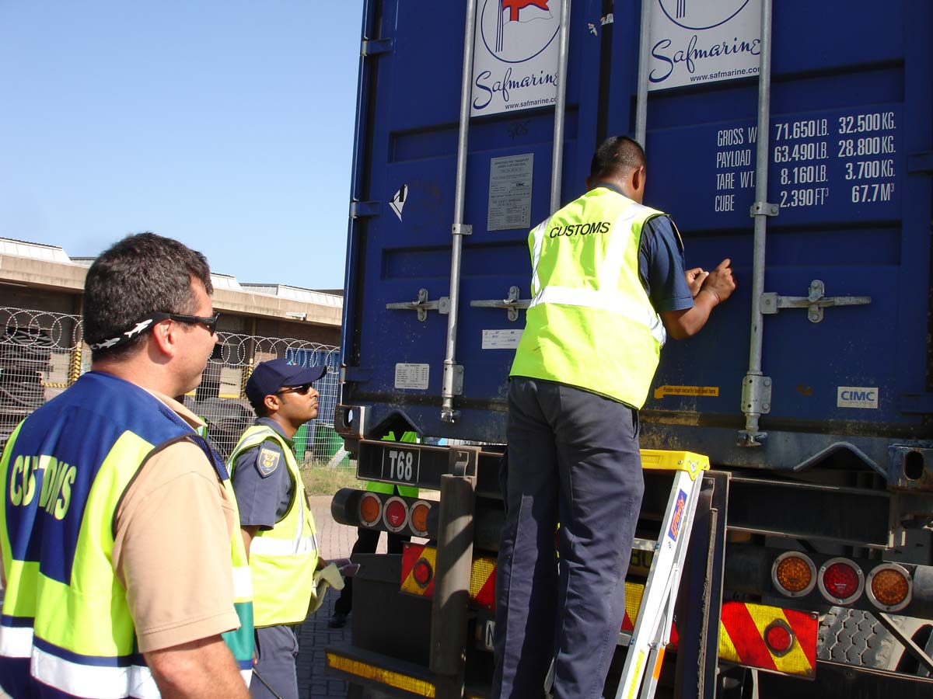
d) Trade facilitation

Slide 22
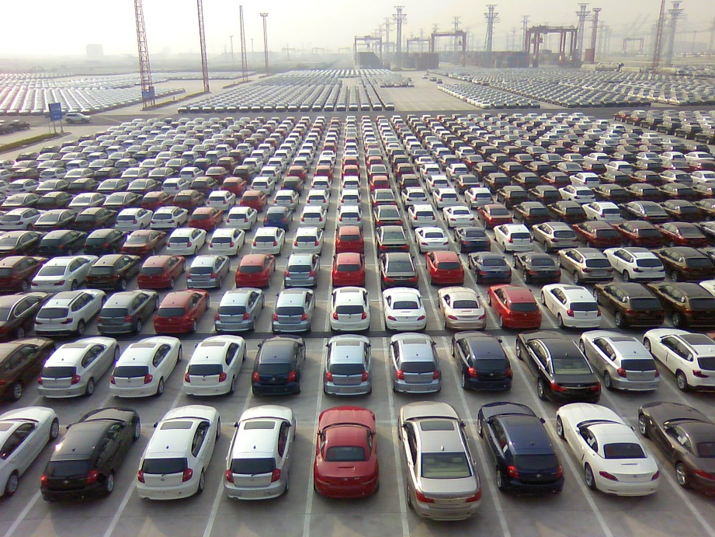
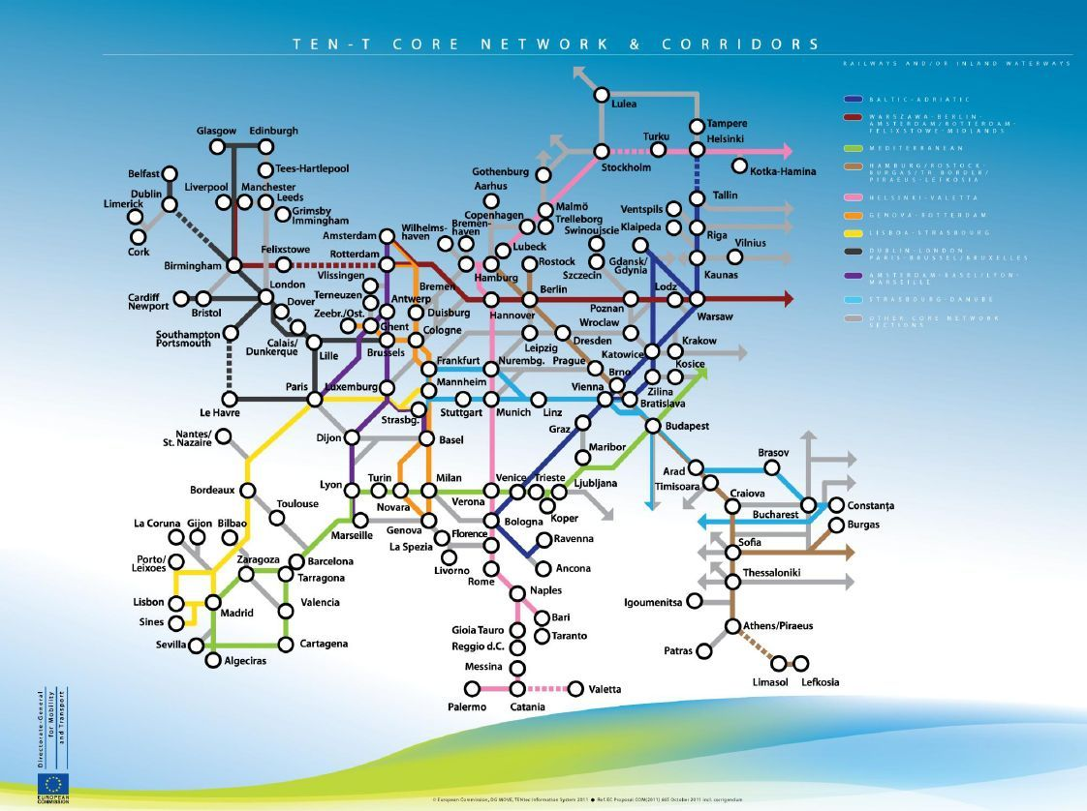
e) Ports and logistics

Slide 23
4. Safety and environment

Slide 24
Air emissions
Ballast water management
Ship recycling
Passenger ship safety
Places of refuge

Slide 25
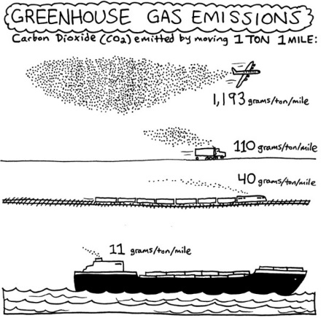
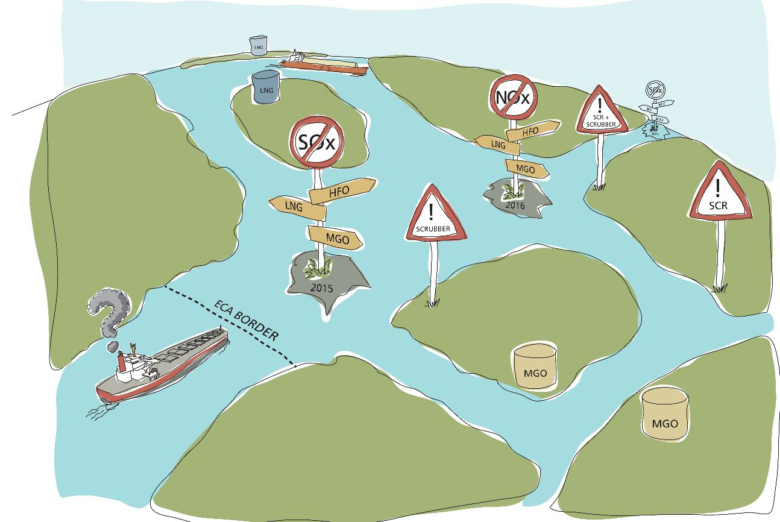
a) Air emissions

Slide 26
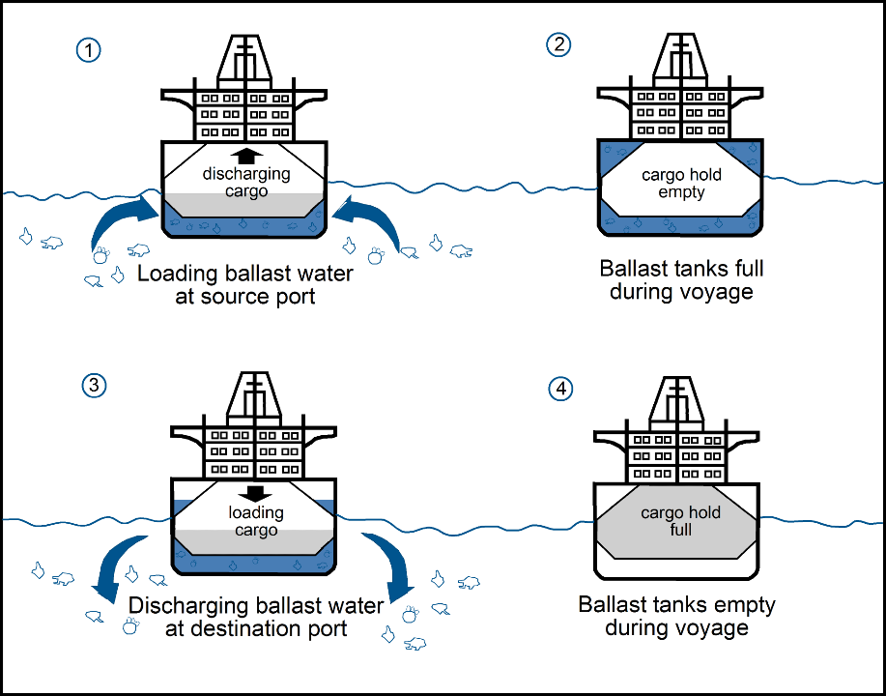

b) Ballast water management

Slide 27
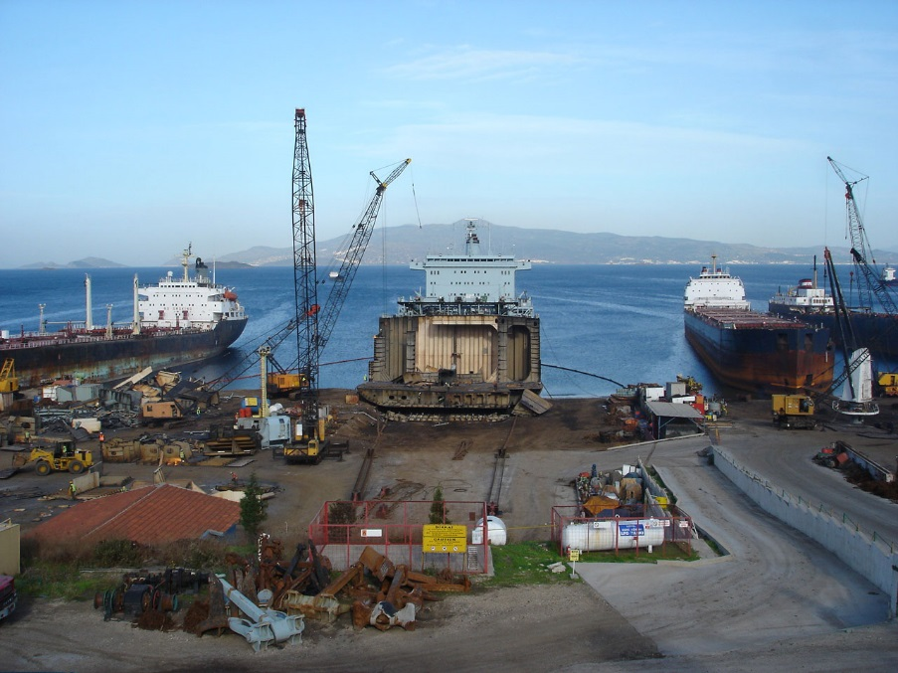
c) Ship recycling

Slide 28


d) Passenger ship safety

Slide 29
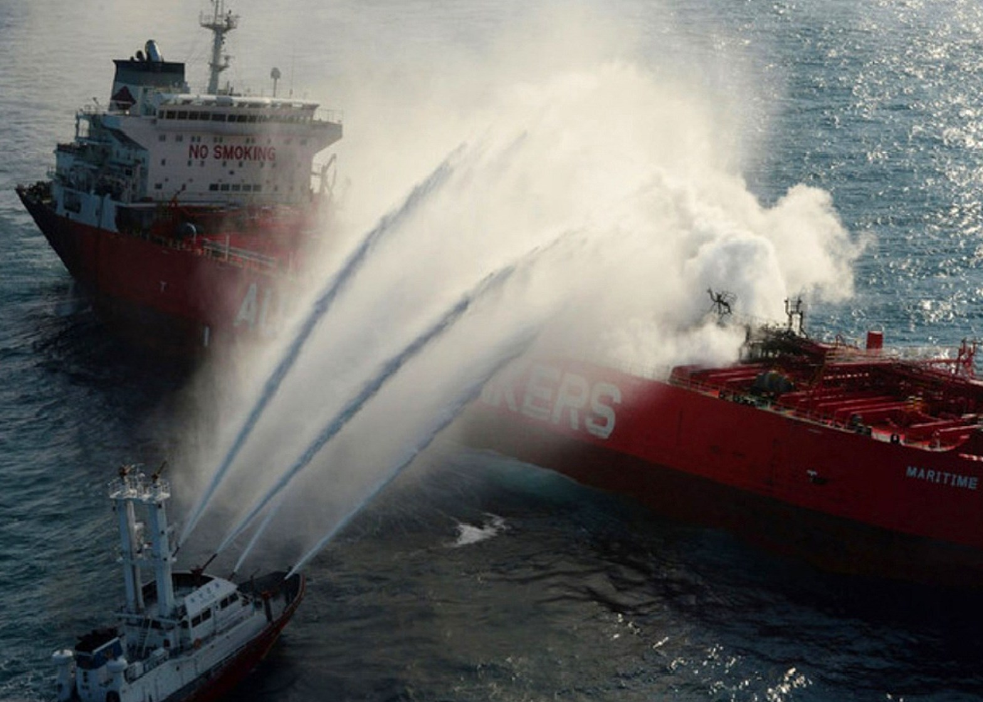
e) Places of refuge

Slide 30
5. Social affairs

Slide 31
Attractiveness maritime careers
STCW recognition
Application EU social Directives
Schengen Visa Code

Slide 32


a) Attractiveness maritime careers

Slide 33
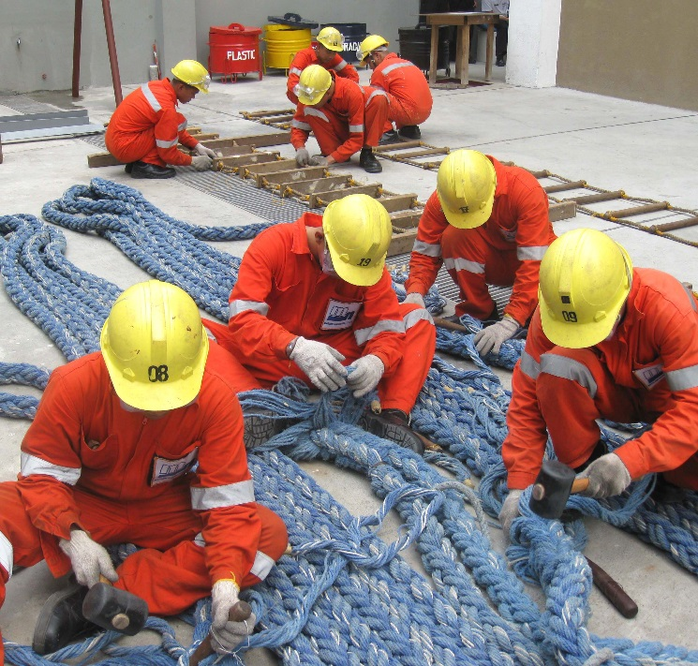

b) STCW recognition

Slide 34
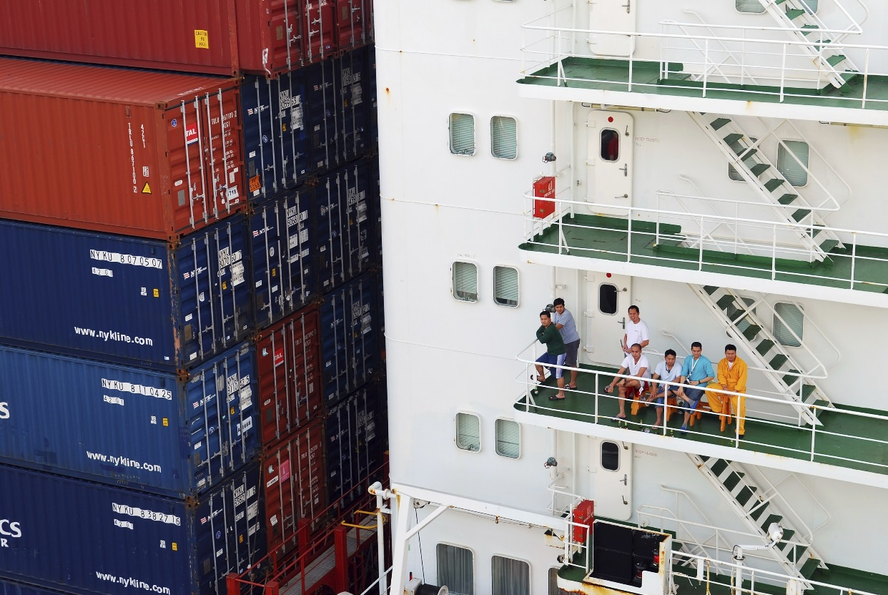
c) Application EU social Directives

Slide 35

d) Schengen Visa Code

Slide 36
6. Conclusions

Slide 37
Policy framework for shipping is diverse and complex
Tensions between international and EU ambitions
‘Athens Declaration’ good basis for future EU policy
Sustaining competitiveness EU shipping is first priority
Shipping lobby must be visible, united and pro-active

Slide 38
Brussels, 2-6 March 2015

Slide 39

Patrick Verhoeven – Secretary General
European Community Shipowners’ Associations (ECSA)
Rue Ducale, Hertogstraat 67/2 – B-1000 Brussels
+ 32 2 510 61 26 – patrick.verhoeven@ecsa.eu – www.ecsa.eu
Follow me on Twitter @PVerhoevenECSA

